Slide 1

Finite State Machine
Ehsan Yazdian

Slide 2
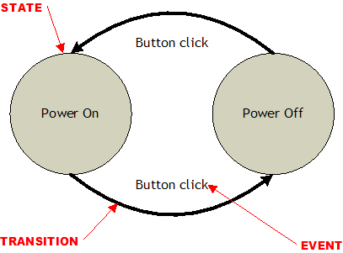
Introduction
A preferred Design methodology for sequential logics.
State machine is
A set of states
A set of input events
A set of output events
A function that maps states and input to output
A function that maps states and inputs to states
A description of the initial state
There are many ways to code FSMs:
Two-always implementation.
Most common,
Easily understood and debug
Efficient implementation

Slide 3
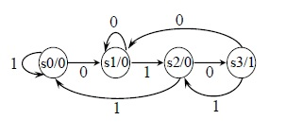
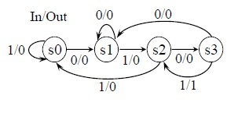
Two Design Approaches:
Moore FSM: outputs are only a function of the present state.
Mealy FSM
One or more of the outputs are functions of the present state and the inputs.
Circuit for Next-state
State registers
Output logic
Inputs
Outputs
Circuit for Next-state
State registers
Output logic
Outputs
Inputs

Slide 4
A Simple and Useful Example
Level To Pulse Converter
Synchronous rising-edge detector
Sample uses: Buttons and switches pressed by humans for arbitrary periods of time, …..

Slide 5
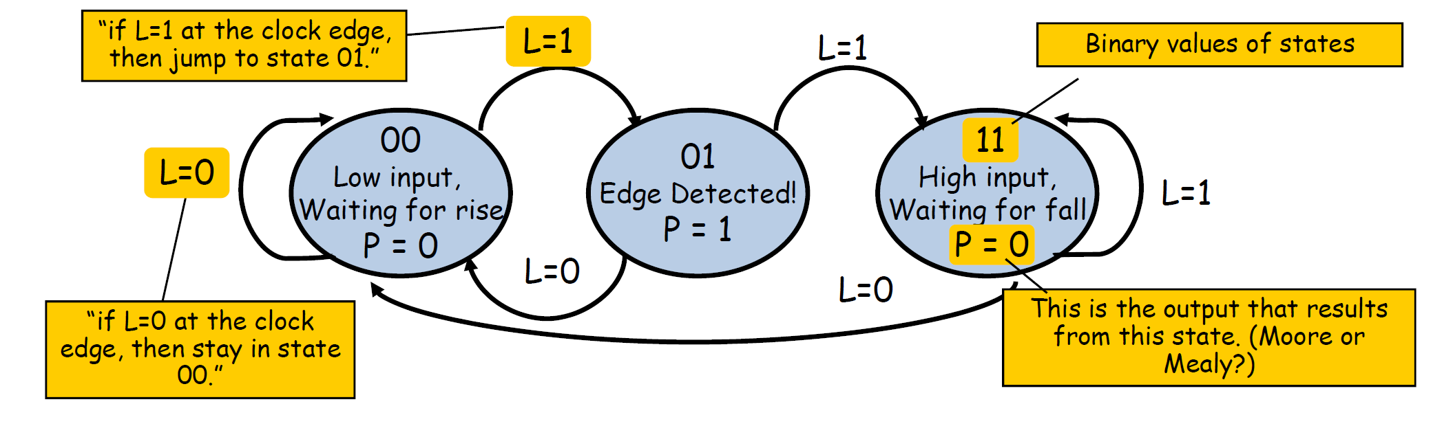
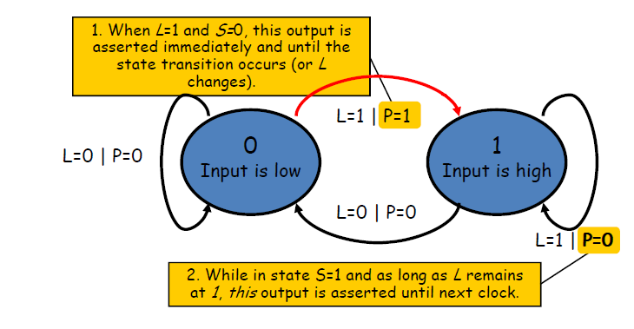
Design Approaches
Could be designed by Moore and Mealy State machines
Moore Design
Mealy Design

Slide 6
Naming the States and Encoding
Guideline: make state assignments using parameters with symbolic state names.
Defining and using symbolic state names makes the Verilog code more readable and eases the task of redefining states if necessary.
Better to use localparam:
States should be visible within the module
localparam
WAIT = 1,
Detect = 2,
Finish = 3;
Declare two variables
current state
next state
reg [1:0] current_state, // Current state
next_state; // Next state

Slide 7
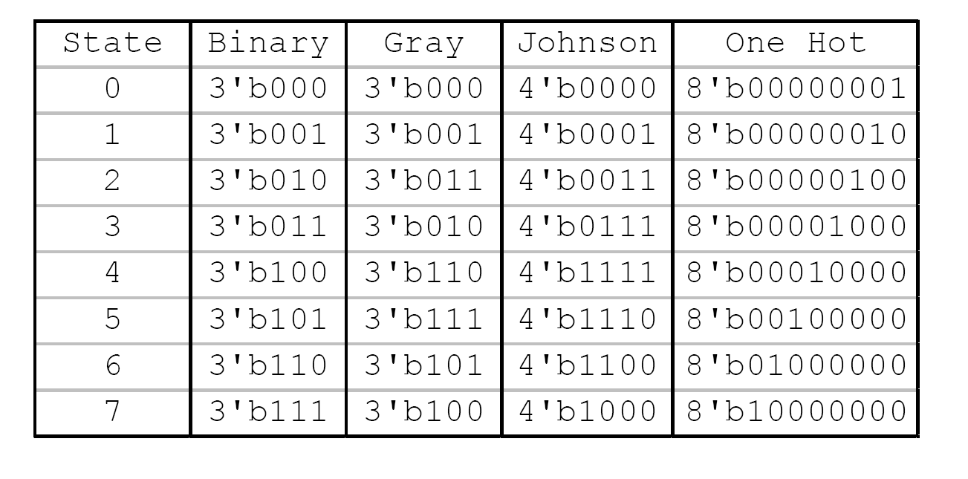

State Encoding
Different ways to encode the state register
Binary
For N states, use ceil(l$og_{2}N$) bits
Most efficient use of state registers,
but requires more complicated combinational logic to detect when in a particular state.
One Hot:
For N states, use N bits to encode the state where the bit corresponding to the current state is 1, all the others 0.
Tradeoffs: more state registers, but often much less combinational logic since state decoding is trivial.
Gray: Efficient size and can have good speed
…..
Which is the best?
Depends on the number of states, inputs to the FSM, complexity of transitions
We can build our FSM and then synthesize it for each encoding and compare size and speed.

Slide 8
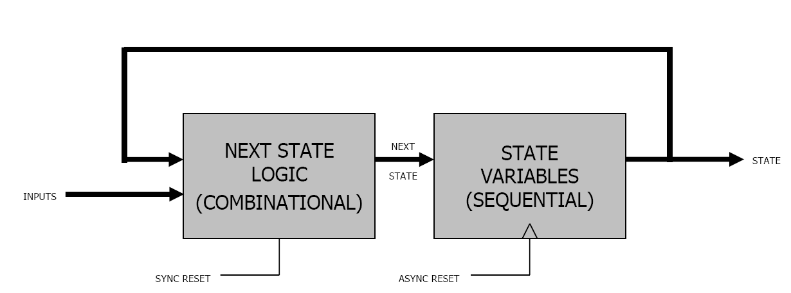
Write Verilog
Two Always Block FSM Style (Good Style)
Most popular Verilog coding styles to describe FSM
One combinational always to generate next-state register and outputs.
Some designers prefer to divide this always to 2 always blocks: one for next sate and the other for outputs.
One sequential always to update current state register

Slide 9
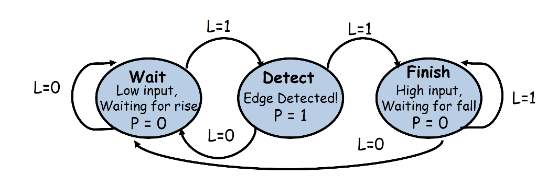
Example (Moore Dsign)
module level_to_pulse(
input L, reset, clk,
output reg P);
reg[1:0] state; //Current State
reg[1:0] next_state;
localparam [1:0]
Wait = 2'b00,
Detect = 2'b01,
Finish = 2'b11;

Slide 10
always @(*) begin // Combinational Always
case(state)
Wait: if (L) next_state = Detect;
else next_state = Wait;
Detect: if (L) next_state = Finish;
else next_state = Wait;
Finish: if (L) next_state = Finish;
else next_state = Wait;
//default: next_state = 2’bxx;
endcase
end
always @(*) begin
next_state = Wait;
case(state)
Wait: if (L) next_state = Detect;
Detect: if (L) next_state = Finish;
Finish: if (L) next_state = Finish;
//default: next_state = 2’bxx;
endcase
end
More Compact
Useful technique to debug state machine designs
Making default next equal all X's assignment
always @(posedge clk or posedge reset) //Sequential Always
if (reset)
state <= Wait;
else
state <= next_state;

Slide 11
Output Logic
Standard Way for combinational output logic
always @(*) begin // Output Logic
case(state)
Wait: P=0;
Detect: P=1;
Finish: P=0;
endcase
Alternative way:
assign P= (state==Detect)? 1:0;

Slide 12
Circuit for Output
Combinational Output
Standard Way for combinational output logic
always @(*) begin // Output Logic
case(state)
Wait: P=0;
Detect: P=1;
Finish: P=0;
endcase
We can combine this always block with the next_state always block;
Alternative way: Dataflow level describing:
assign P= (state==Detect)? 1:0;
Registered Output:
always @(posedge clk) begin // Output Logic
case(state) //case(next_state)
Wait: P<=0;
Detect: P<=1;
Finish: P<=0;
endcase
state: One clock delay
next_State: No delay

Slide 13
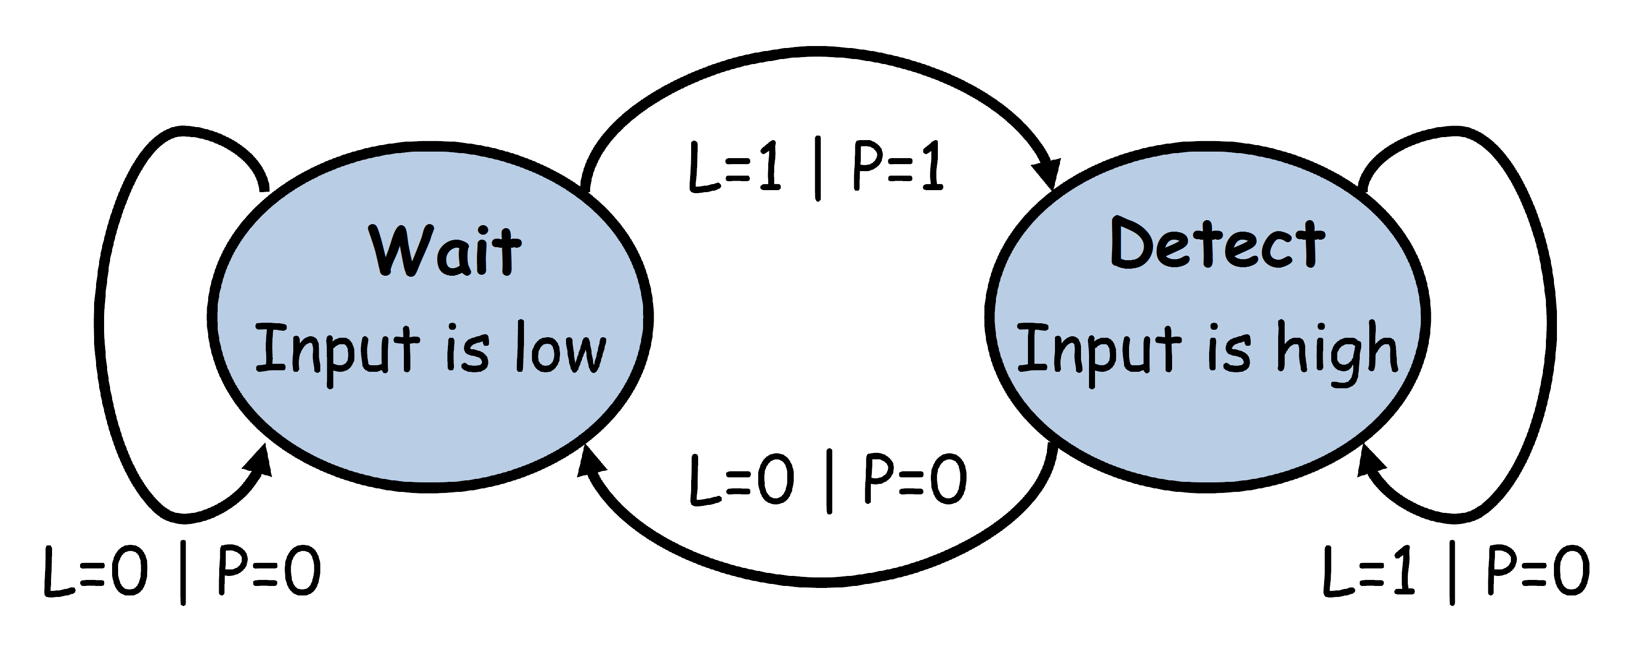
Example (Mealy Dsign)
module level_to_pulse(
input L, reset, clk,
output reg P);
reg[1:0] state; //Current State
reg[1:0] next_state;
localparam [1:0]
Wait = 1'b0,
Detect = 1'b1;

Slide 14
always @(*) begin // Combinational Always
case(state)
Wait: if (L==1) next_state = Detect;
else next_state = Wait;
Detect: if (L==0) next_state = Wait;
else next_state = Detect;
endcase
end
always @(*) begin // Combinational Always for Output
case(state)
Wait: if (next_state = Detect)
P=1;
else P=0;
Detect: P=0;
endcase
end
always @(posedge clk or posedge reset) //Sequential Always
if (reset)
state <= Wait;
else
state <= next_state;

Slide 15
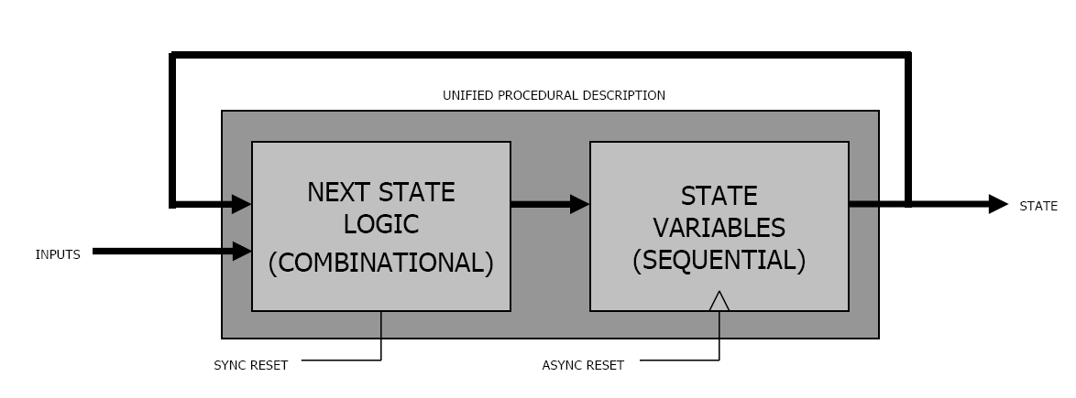
One Always Block FSM Style
One of the most common FSM coding styles in use is the one sequential always block FSM coding style.
For most FSM designs, the one always block FSM coding style is more verbose, more confusing and more error prone than a comparable two always block coding style.
Implicit next state signal

Slide 16
Comparing Moore and Mealy Design
a Mealy FSM might be more difficult to conceptualize and design
Have fewer states
Output Glitching
FSM state bits may not transition at precisely the same time
Combinational outputs may contain glitches
Registered FSM Outputs are Glitch-Free

Slide 17
Example (Moore Dsign)
module level_to_pulse(
input L, reset, clk,
output reg P);
reg[1:0] state; //Current State
reg[1:0] next_state;
localparam [1:0]
Wait = 2'b11,
Detect = 2'b01,
Finish = 2'b11;
always @(posedge clk or posedge reset)
if (reset)
state <= Wait;
else begin
case(state)
Wait: if (L) state = Detect;
else state = Wait;
Detect: if (L) state = Finish;
else state = Wait;
Finish: if (L) state = Finish;
else state = Wait;
endcase
end

Slide 18
Example Detect input sequence 1101
din
fsm
clk
dout
clr
din
dout
1 0 1 1 0 1 1 0 1 0 0 1 1 0 1 0
0 0 0 0 0 1 0 0 1 0 0 0 0 0 1 0

Slide 19
Moore State Diagram Detect input sequence 1101
0
S1
0
1
1
S0
0
0
S11
0
0
CLR
1
0
1
0
S1101
1
S110
0
1

Slide 20
seqdet.v
din
seqdet
clk
dout
clr
// Sequence detector -- Detect 1101
module seqdet(clk, clr, din, dout);
input clk, clr, din;
output dout;
reg dout;

Slide 21

seqdet.v
reg[2:0] next_state, present_state;
clr
dout
din
parameter S0 = 3'b000, S1 =3'b001, S11 = 3'b010,
S110 = 3'b011, S1101 = 3'b100;

Slide 22
seqdet.v
always @(posedge clk or posedge clr)
begin
if (clr == 1)
present_state <= S0;
else
present_state <= next_state;
end
clr
dout
din

Slide 23
seqdet.v
// C1: Next State
always @(present_state or din)
begin
case(present_state)
S0: if(din == 1)
next_state = S1;
else next_state = S0;
S1: if(din == 1)
next_state = S11;
else next_state = S0;
S11: if(din == 0)
next_state = S110;
else next_state = S11;
S110: if(din == 1)
next_state = S1101;
else next_state = S0;
S1101: if(din == 0)
next_state = S0;
else next_state = S11;
default next_state = S0;
endcase
end
0
S1
0
1
1
S0
0
0
S11
0
CLR
0
1
0
1
S1101
1
0
S110
0
1

Slide 24
seqdet.v
// C2: Outputs
always @(present_state)
begin
if(present_state == S1101)
dout <=1;
else
dout <= 0;
end
endmodule
clr
dout
din

